Slide 1
Proposed Budget
FISCAL YEAR 2022 - 2023

Slide 2
Revenue for Fiscal Year 2022 – 2023 - Rodriguez
Tax Revenue (District Assessed Value –URD x tax rate x collection rate) $1,500,923
Conflagration Income (estimate based on prior years) $170,000
General Fund $2,424,414
Public Education Revenue $8,000
Miscellaneous Revenue (fees, refunds, reimbursements, HKV Contract) $42,795
Cash Carryover $699,164

Slide 3
Administrative Program - Rodriguez
Themes Supported by Program: Community Partnership, Fiscal Responsibility, People
Objectives Supported by Program: Customer Service, Budget Accountability, Information Technology, Teamwork, Retention, Recruitment
Mission: The Administrative Program provides for the daily and ongoing functions of the Fire District, its programs and activities.
Administrative expenses are projected to increase by almost 23%
6001 Contracted professional services, up almost $24k due to
Cyber Security and increased audit expenses.
6010 Office Supplies increased due to additional newsletter printing
and replacement plan for administrative computers
Insurance, Dues, Fees, & Subscriptions, Utilities, Communications
all on the rise.
Publications & Elections increased 5x due to 3 seats up for re-election

Slide 4
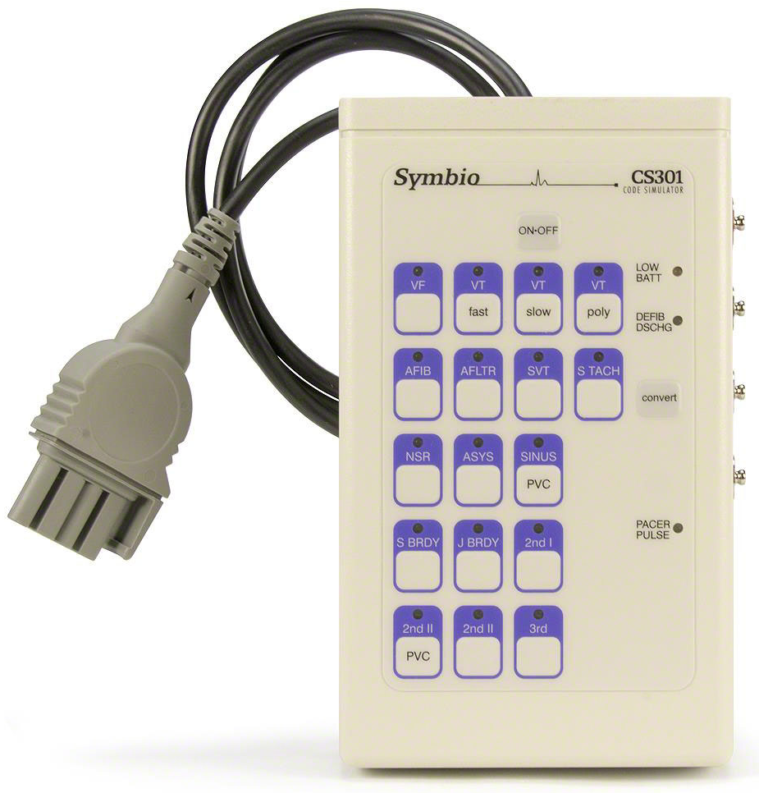
EMS Program - Ferguson
Themes Supported by Program: Fire & Life Safety
Objectives Supported by Program: Life & Safety Medical, Response
Mission: Provide the highest quality pre-hospital care as the Quick Response Team (QRT) including Advanced Life Support (ALS), when staffing allows
Overall program cost reduced due to no capital purchases, however 6210 Medical Supplies increased 16% to reflect additional supplies needed for higher call volume and increased cost of materials.

Slide 5
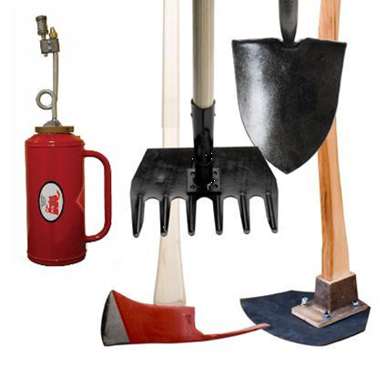
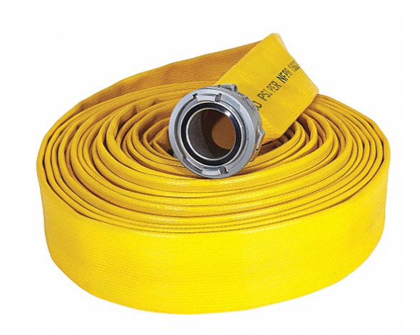
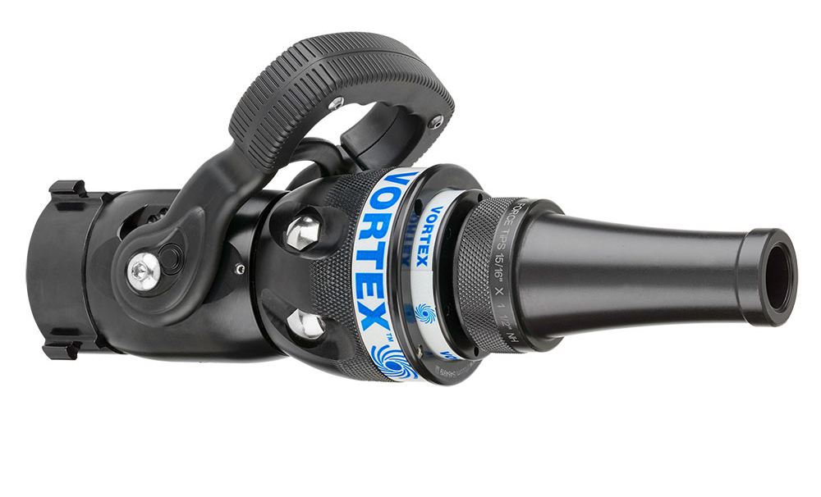
Suppression Program - Ferguson
Themes Supported by Program: Fire & Life Safety
Objectives Supported by Program: Suppression
Mission: To provide the tools and equipment necessary for Philomath Fire & Rescue firefighters to aggressively fight fire while providing for safety first.
Suppression Program reduced 2.7% due to
no capital outlay.

Slide 6
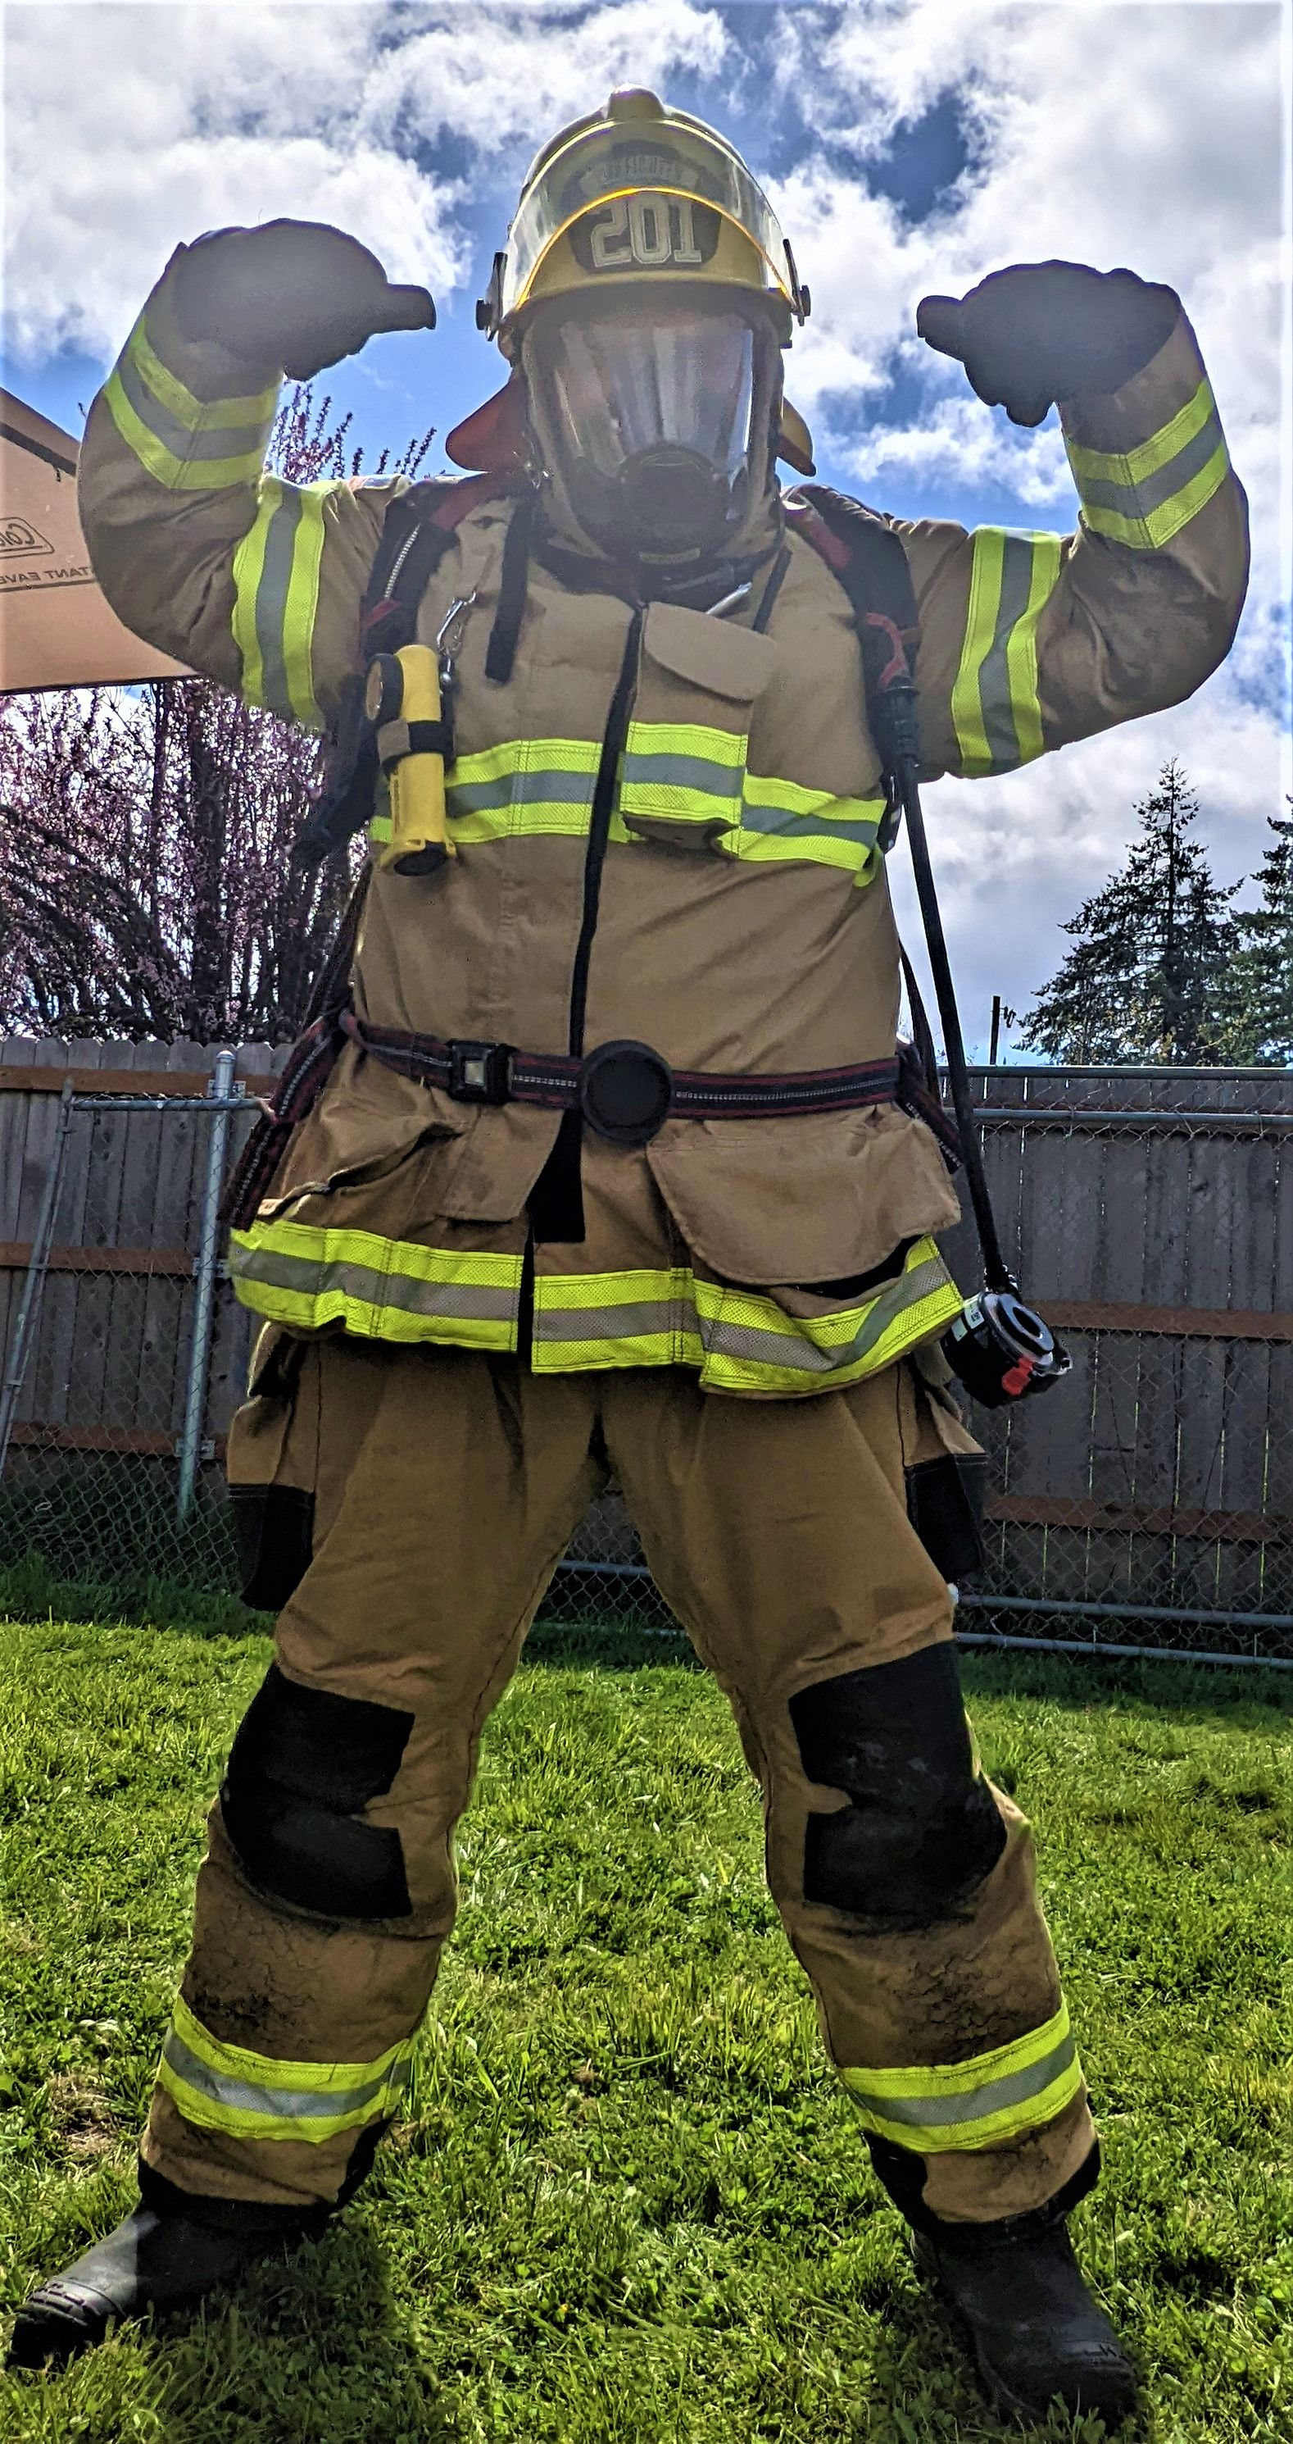
Safety Program - Ferguson
Themes Supported by Program: Fire & Life Safety, People
Objectives Supported by Program: Suppression, Response, Training, Teamwork, Recruitment
Mission: To protect our personnel through providing personal protective equipment, bi-annual physicals, and other protective measures.
Overall program increase of 3.6%.
Significant reshuffling of funds in the program. Changes in provider for turnouts and distribution of new turnouts among personnel brought 6250 line down 18%.
Increase for 6310 of almost 100% due to current recruitment practices necessitating more physicals for new recruits on top of bi-annual physical for current personnel.

Slide 7
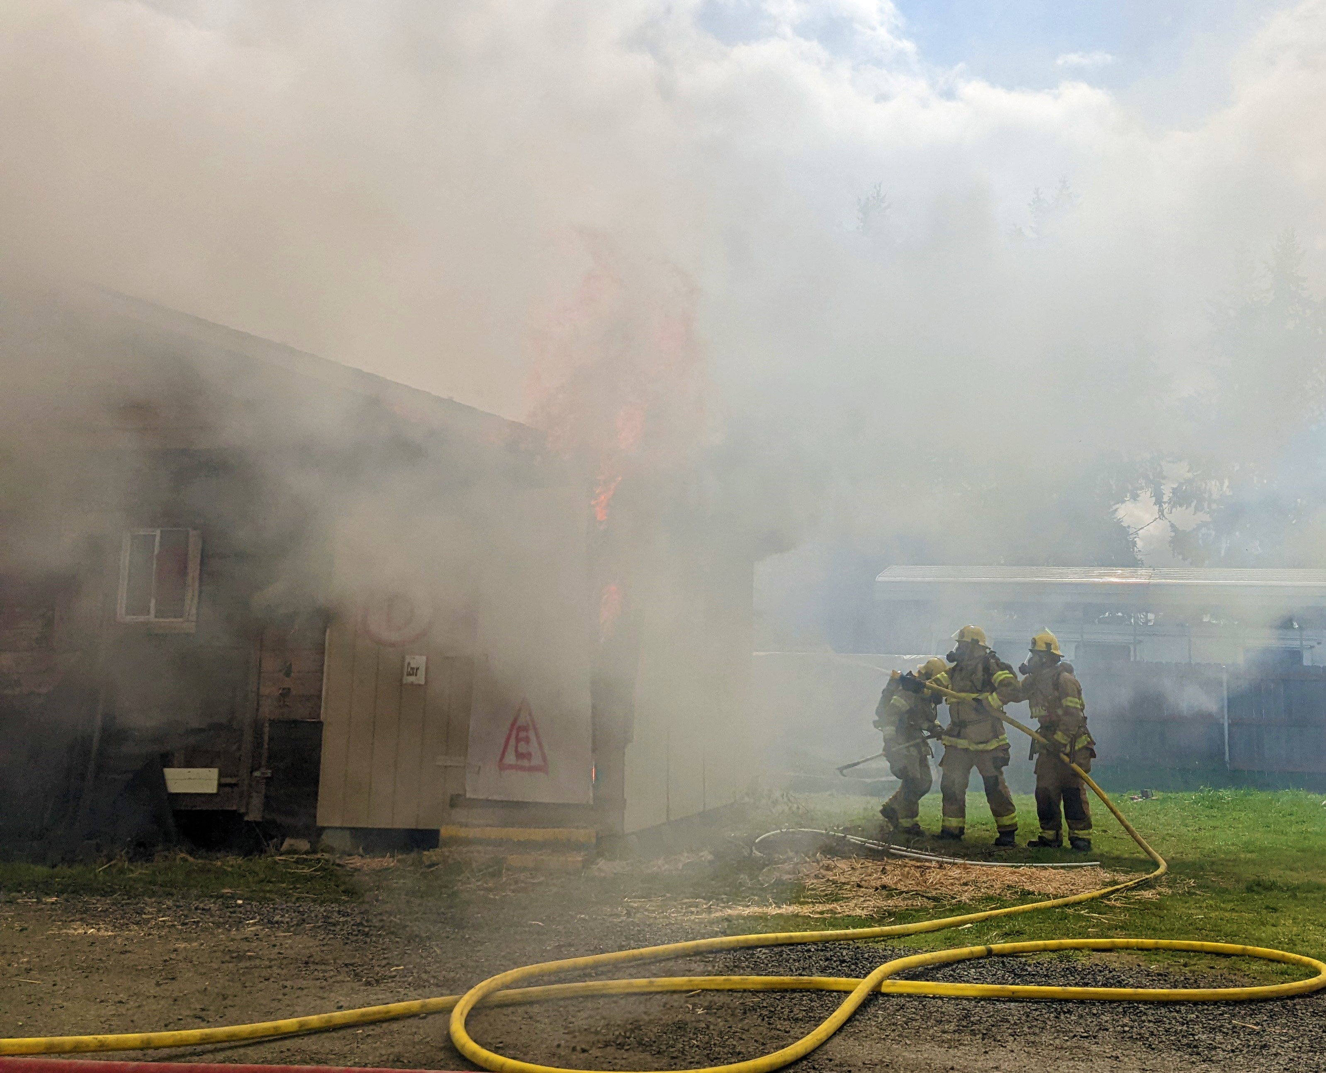
Training Program - Ferguson
Themes Supported by Program: Fire & Life Safety, People
Objectives Supported by Program: Response, Training, Teamwork, Recruitment
Mission: To provide high quality training opportunities in fire suppression, prevention, investigation, and emergency medical services for all Philomath Fire & Rescue personnel.
Not even a 1% increase in this program (omitting AFG grant not received last year).
Some expenses reorganized to Community Outreach under the Administrative Program.

Slide 8
Prevention & Public Education - Saalsaa
Themes Supported by Program: Fire & Life Safety, Community Partnership
Objectives Supported by Program: Prevention, Customer Service, Education
Mission: Prevent life and property loss in the community through code enforcement, public education, fire investigation, plans review, and pre-fire assessments.
Approximately 4% increase, ~$400

Slide 9
Emergency Communications & Mapping - Ferguson
Themes Supported by Program: Fire & Life Safety
Objectives Supported by Program: Response
Mission: Provide radio and alarm communications for fire department stations, apparatus and personnel.
37% decrease in program costs.

Slide 10
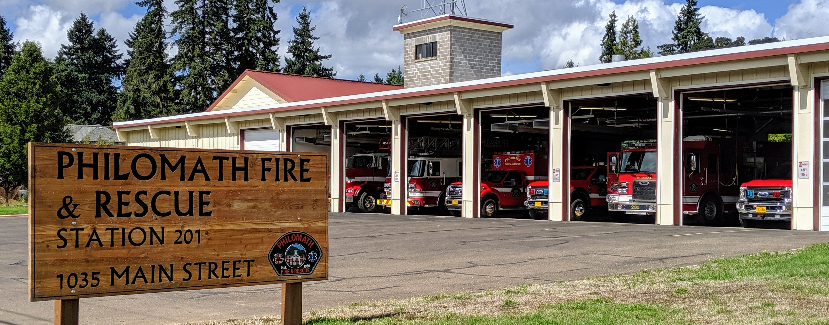
Building & Grounds Maintenance - Ferguson
Themes Supported by Program: Community Partnership, Fiscal Responsibility, People
Objectives Supported by Program: Customer Service, Capital Maintenance, Retention
Mission: Maintain and improve the condition of Philomath Fire & Rescue's buildings and grounds.
10% reduction in program expenses due to de-prioritizing grounds maintenance and projects.

Slide 11
Vehicle & Equipment Maintenance - Ferguson
Themes Supported by Program: Fire & Life Safety, Fiscal Responsibility
Objectives Supported by Program: Response, Capital Maintenance,
Mission: To maintain the apparatus and equipment in a constant state of readiness and to ensure it is safe to operate.
20% increase for fuel due to rising prices
15% increase in vehicle maintenance and repair.

Slide 12
Personnel Expenses - Rodriguez
~ 68% of Fiscal Year 2022-2023 Operating Budget
13% increase in Personnel Expenses from prior fiscal year ($140k)
Wages up 10% (6% personnel, 21% conflag, $8k extra hire)
PERS increase 27% reflecting changes in the PERS program contribution and increased wages.
Conflagration wages increased based on 7-year average

Slide 13
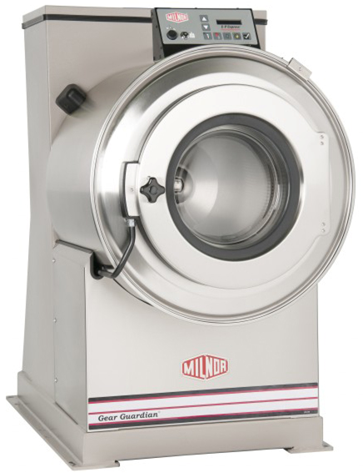
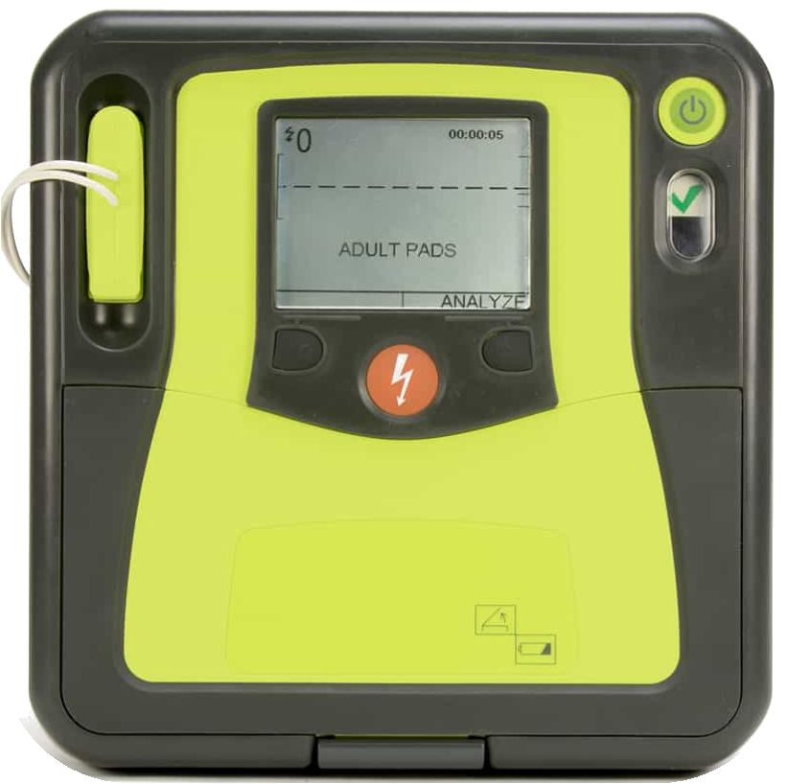
Reserve Funds – Ferguson & Rodriguez
Building Reserve Planned Expenditures:
Pole Barn, Turnout Washer, Training House Removal & Replacement, Concrete Repair @ 201, Hose Tower Roof Repair*
Equipment Reserve Planned Expenditures:
SCBA Replacement Planning, Cyber Security Equipment, 2 Additional AEDs, System Development Cost Contracting (SDCs aka impact fees)

Slide 14
Thank You 1

